Slide 1
Introduction to
Guidelines for Indian Government Websites (GIGW),
Web Content Accessibility Guidelines (WCAG 2.0) and
W3C MobileOk

Slide 2
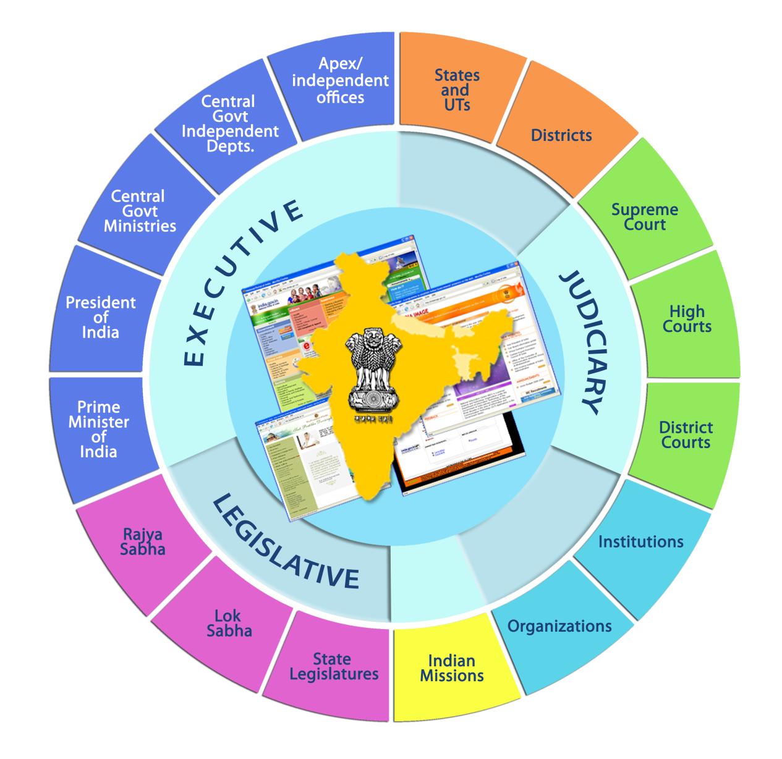
Indian Government web space representing all tiers of governance

Slide 3
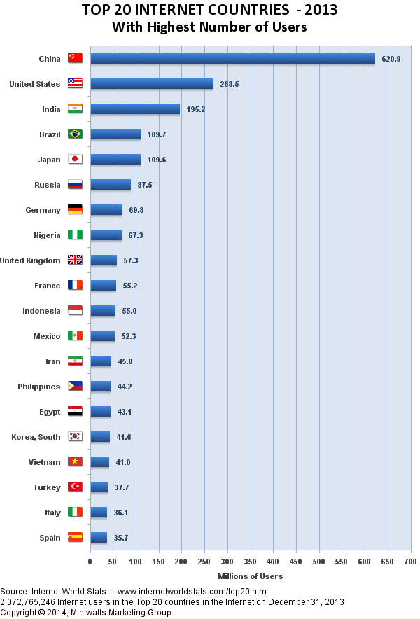

Slide 4
Some other countries who are having their own sets of Guidelines
United States
United Kingdom
Germany
France
New Zealand
Italy
Canada
Switzerland
Netherlands
Sweden

Slide 5
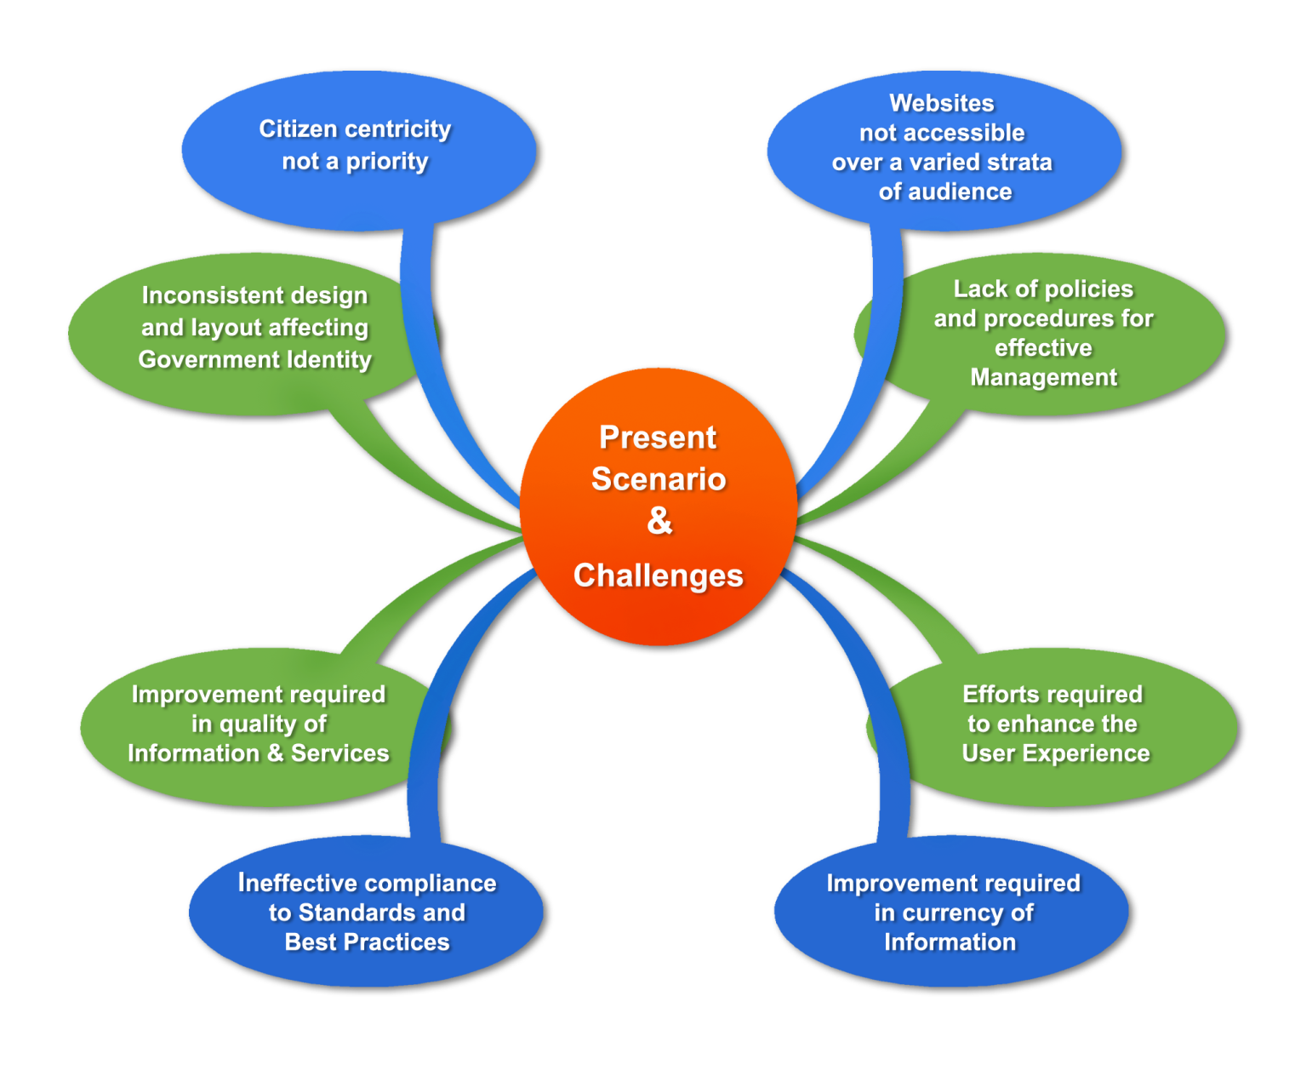
Government Webspace: Challenges

Slide 6
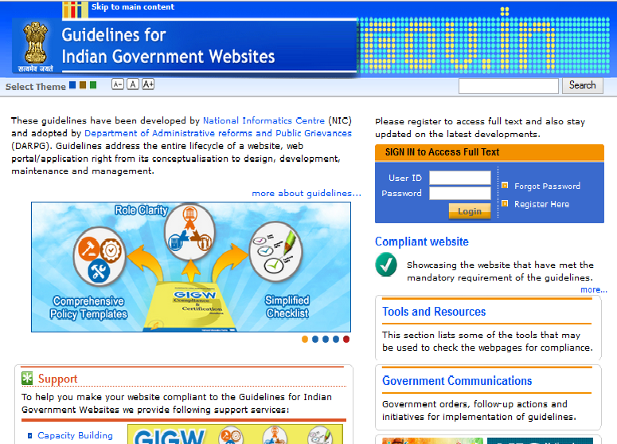

Need was felt to set up a mechanism to ensure certain minimum standard for all government websites. Consequently
‘Guidelines for Indian Government websites’ ( GIGW)
were developed
http://web.guidelines.gov.in/

Slide 7
Guidelines for Indian Government Websites (GIGW)
An Integral Part of Central Secretariat Manual of Office Procedure
Prepared by National Informatics Center
Adopted by Department of Administrative Reforms and Public Grievances(DARPG)
Published in January 2009.
Online: http://web.guidelines.gov.in/

Slide 8
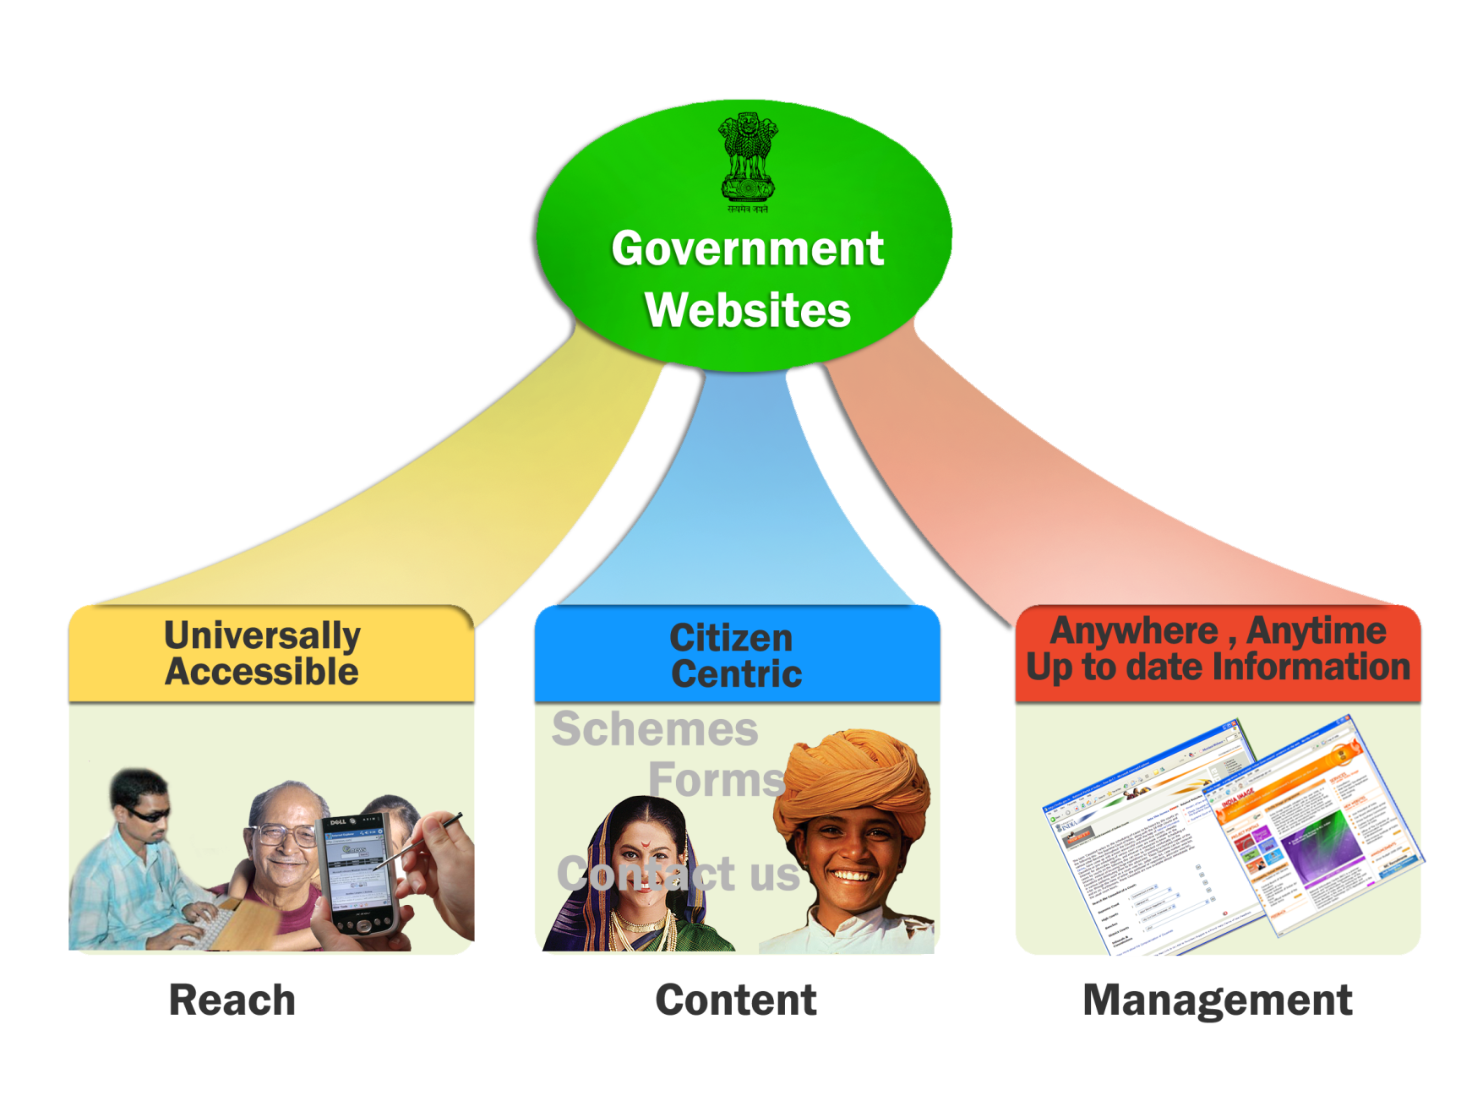
Three Focus Domains of GIGW
Notes:
Universal Accessibility: (Pg 4 GIGW)
The term ‘Universal Accessibility’ refers to making a website accessible to ALL irrespective of technology, platforms, devices or disabilities of any kind. In other words, Departments should consider the needs of a broad spectrum of visitors, including general public, specialised audiences, people with disabilities, those without access to advanced technologies, and those with limited English proficiency. Guidelines to address the above
needs have been given in various sections of this document.
Most pertinent guidelines have been placed in the mandatory category while others have been made advisory or voluntary. Following the mandatory guidelines shall insure compliance to W3C Web Content Accessibility Guidelines (Level A)
Citizen Centric: (Pg 33 GIGW)
Examples of Citizen Centric Services are About us, Schemes, Services, Forms, Acts, Documents, Circulars and Notifications, News and Press Releases, Contact Us, Presence on the National Portal
Website Management Team: (10.1.1 Pg 97 GIGW)
Departments MUST appoint a Web Information Manager whose role shall be to ensure that there is a proper flow of content to the site and that content quality and user satisfaction issues are taken care of. To achieve this she/he has to coordinate with the various groups within the Department. The Web Information Manager should undertake the following activities with regard to the Indian Government website being maintained by her/him.
• Formulation of policies concerning management of content on the web through its entire life cycle viz. Creation, Moderation, Approval, Publishing and Archival. Ensuring that all content on the website is always authentic, up-to-date and obsolete information or services are removed.
• Set a mechanism for periodically validating links to related information. An automated report can provide a list of broken links on the site, which can be immediately corrected.
• Ensuring the entry of the website at a prominent rank in all the major search engines so that the site’s visibility is enhanced and users are made aware of its address.
• Web Information Manager is overall responsible for quality and quantity of information and services on the website. The complete contact details of the Web Information Manager must be displayed on the website, so that the visitor could contact him/her in case of some queries or requirements.
• Since the websites receive a lot of feedback/query mails from the visitors, it is the responsibility of the Web Information Manager to either reply to all of them himself/herself or designate someone to regularly check and respond to the feedback/query mails.
Website Monitoring (10.3 Pg 99 GIGW)
Web being a dynamic medium, changes in terms of technologies, access devices and even the requirements and expectation levels of visitors happen fairly frequently. Keeping this in mind, Indian Government websites MUST have a website monitoring policy in place.Websites must be monitored periodically in accordance with the plan to address and fix the quality and compatibility issues around the following parameters:
a. Performance: Site download time should be optimised for a variety of network connections as well as devices. All important pages of the website should be tested for this.
b. Functionality: All modules of the website should be tested for their functionality. Moreover, interactive components of the site such as discussion boards, opinion polls, feedback forms etc. should be working smoothly.
c. Broken Links: The website should be thoroughly reviewed to rule out the presence of any broken links or errors. A number of tools and techniques are
now available to easily detect the broken links in a websited.
d. Traffic Analysis: The site traffic should be regularly monitored to analyse the usage patterns as well as visitors’ profile and preferences. Traffic Analysis tools also give reports on broken links.
e. Feedback: Feedback from the visitors is the best way to judge a website’s performance and make necessary improvements. A proper mechanism for
feedback analysis should be in place to carry out the changes and enhancements as suggested by the visitors.
Website Policies (10,7 Pg 103 GIGW)
Websites represent the face of the department in the cyber world. Like the Department itself, the website also has to continually grow and evolve. As the website grows in size and reach the expectations of the citizen also grow. It is therefore important that we set down rules and regulations to operate and manage the websites effectively. Although different policies and their need and purpose is explained in various sectionsof this document for the sake of convenience, a complete list of policies along with the section are referenced below.
S.No. Policy Ref No.
1. Copyright Policy 3.1
2. Hyper linking Policy 3.2
3. Terms & Conditions 3.3
4. Privacy policy 3.4
5. Content Contribution, Moderation and Approval Policy (CMAP) 5.2.1
6. Web Content Review Policy (CRP) 5.2.3
7. Content Archival Policy (CAP) 5.2.6
8. Website Security Policy 7.7.2
9. Website Monitoring Policy 10.3
10. Contingency Management 8.3
All the above policy MUST be duly approved by the Head of the Department.

Slide 9

Scope
Guidelines address the entire lifecycle of the site –planning content design development
hosting management
The "Guidelines for Indian Government Websites" complies with World Wide Web Consortium (W3C) Web Content Accessibility Guidelines (WCAG) 2.0 level A.
Enable people with visual impairments access the sites using assistive technologies, such as screen readers.

Slide 10
Objectives/ Benefits of Compliance
Improve the usability quotient and technical competence of sites vis-à-vis International Standards.
Facilitate sites in achieving citizen-centricity while providing anytime anywhere delivery of information and services.
Formulate policies for sustenance and effective maintenance of the sites through their life cycle.
Achieve a certain degree of commonality and standardization across the sites.
Enhance Government-Citizen Relationship

Slide 11
GIGW Compliance
The guidelines are divided into three categories
  Mandatory: The usage of term 'MUST' signifies requirements which can be objectively assessed and which the Departments are supposed to mandatorily comply with.
  Advisory: The usage of term ‘Should' refers to recommended practices or advisories that are considered highly important and desirable but for their wide scope and a degree of subjectivity these guidelines would have otherwise qualified to be mandatory.
  Voluntary: The usage of the term ‘May' refers to voluntary practice, which can be adopted by a Department if deemed suitable.
115 mandatory guidelines are presented as a checklist for ready reference & evaluation
Notes:
Mandatory: The usage of term ‘MUST’ signifies requirements which can be objectively assessed and which the Departments are
supposed to mandatorily comply with. It is anticipated that there will be no exceptions for a Department not complying with these. In the case of any Department, these guidelines shall apply to all the WebPages/websites under the ownership of that Department. The websites will be checked against these guidelines when audits for compliance are undertaken or for the purpose of quality certification. It is the responsibility of each Department to address and bring into compliance, any non-compliant issues found in any website under their ownership.
Advisory: The usage of term ‘should’ refers to recommended practices or advisories that are considered highly important and desirable but for their wide scope and a degree of subjectivity these guidelines would have otherwise qualified to be mandatory. Departments are, however, expected to comply with these advisories.
The lineage of the Department should also be indicated at the bottom of the Homepage and all important entry pages of the website. For instance, at the bottom of the Homepage, the footer may state the lineage information, in the following manner:
‘This Website belongs to Department of Heavy Industries, Ministry of Heavy Industries and Public Enterprises, Government of India’ (for a Central Government Department). Pg 11 (GIGW)
Voluntary: The usage of the term ‘may’ refers to voluntary practice, which can be adopted by a Department if deemed suitable. These have been drawn from good practices and conventions that have proved successful and can help a Department achieve high quality benchmarks for their web endeavours.
All currently open vacancies may be highlighted on the Homepage of the website. (Pg 41 GIGW)

Slide 12
Key Guidelines..
Government of India Identifiers: use of Emblem/ logo, registered under 'gov.in' or 'nic.in' domain, link to the National Portal, ownership information
Building Confidence: Copyright, source of documents mentioned, terms & conditions, secure e-Commerce transactions, Privacy Policy, Hyper Linking Policy

Slide 13
Key Guidelines..
Scope of Content:
  Primary: about us, schemes, services, Forms, Acts, documents, Circular and Notifications, Tenders and Recruitment, News and Press Releases, contact us, presence on the National Portal
  Secondary and Tertiary: Feedback Form, help available, Website free from offensive/ discriminatory language, outdated announcements removed, Discussion Forums moderated

Slide 14
Key Guidelines
Quality of Content: Clear and simple language, citizen orientation, CMAP, last updated /reviewed date, Consistency in nomenclature
Design: Consistence page layout, National identity symbols, Text is readable both in electronic and print format, adequate contrast between text and background color
Development: Metadata, multiple browsers compliant, Security Audit by certified agency, Security Policy

Slide 15
Key Guidelines..
Hosting: sites accessible 24x7, Service Provider possesses state-of-the art security infrastructure, Department has contingency plan in place
Website Promotion: Site ranks in the first 5 results on search engines, stationery/ advertisements/ public messages of the department display the URL
Website Management: Department has nominated a Web Information Manager, has a monitoring policy, policies are approved by HoD

Slide 16
GIGW Compliance Assessment
Out of these 115 mandatory guidelines
  12% can be fully tested with automated tools
  28% can be partially tested with tools but require manual verification
  40% need Expert Evaluation
  20% need Self Certification
Notes:
Accessibility is about persons with disabilities. It is not possible for a tool alone to claim that a web page or a web application is accessible. Often, accessibility testing is being conducted by using an automated testing tool. To ensure compliance of websites or even to maintain websites this is an important strategy, but we must not ignore the fine print of most accessibility testing tools. Most of these tools will mention that human intervention or checks are required. For example, a testing tool can tell you whether an image has been given an alternate text but it cannot tell you whether the alternate text is accurate. This check needs to be conducted manually.
One of the key areas that we need to invest in is Manual testing along with automated testing tools.
In addition, the users that we are building inclusion for are people with disabilities and they have very diverse needs. It is also important to conduct User testing with different types of disabilities to ensure that the website or web application is truly accessible by different user groups. Persons with disabilities actually test the website or application using their assistive technology which might be a screen reader, screen magnifier, reading writing tool, on-screen keyboard, etc.
Validation tools: HTML, CSS, Broken Links
Validation tools are used to check the code for standards compliance. HTML validators , CSS validators and broken link (or dead links) checkers are a few such tools. Following URLs point to some validation tools:
http://validator.w3.org (HTML)
http://jigsaw.w3.org/css-validator/ (CSS)
http://www.cssportal.com/css-validator/ (CSS)
http://juicystudio.com/services/csstest.php#csscheck (CSS)
http://validator.w3.org/checklink/ (Broken Links)
http://juicystudio.com/services/linktest.php (Broken Links)
Accessibility
Accessibility is an important idea behind many web standards. Designing accessible websites will help in creating an inclusive digital world. Accessibility compliance of the Website may be checked at:
http://wave.webaim.org/
http://www.stanford.edu/group/accessibility/cgi-bin/accessibilitychecker/checker/index.php
http://www.etre.com/tools/accessibilitycheck/
Mobile friendliness
Browsing the web is not limited to Personal Computer and Laptops any more. Mobile devices are providing alternate and easy connectivity to Internet. Reach of your website will increase with its availability on mobile devices. Mobile-friendliness of your website may be checked at:
http://validator.w3.org/mobile/

Slide 17
Some compliant websites
National Portal
DeitY
Ministry of External Affairs (MEA)
GOI Web Directory
National Advisory Council
Ministry of Social Justice and Empowerment
Cabinet Secretariat
Rajbhawan Uttarakhand
Source: guidelines.gov.in

Slide 18
Compliance is recognized by…
National Award for Best Accessible Website for Persons With Disabilities by the M/o Social Justice and Empowerment
Web Ratna Awards (instituted under the overall ambit of the National Portal of India) to recognise innovative e-Governance initiatives – carries weight-age for compliant sites
National Index for Government Websites primarily based on the compliant sites – includes State and District websites
Notes:
18

Slide 19
Website Development Approach
Nominate Web Information Manager at a senior level
Set up a team and formulate policies to monitor & manage site
Identify citizen centric information & services
Develop Information Architecture for better Accessibility & Navigation
Redesign/ upgrade the site in compliance to the Guidelines

Slide 20
Gap Analysis of Websites already done
Sr No. | Portal | GIGW Compliance 1st Round | GIGW Compliance 2nd Round
1 | farmer.gov.in | 37.38% | 90.36%
2 | seednet.gov.in | 54.66% | 57.89%
3 | nhm.nic.in | 66.19% | 66.19%
4 | pensionersportal.gov.in | 82.71% | 84.89%
5 | haryanafood.gov.in | Not Working previously | 47.22%
6 | foodsuppb.nic.in | 59.72% | 67.10%
7 | www.edistrict.biharonline.gov.in/ | 41.66% | 57.14%
8 | mdm.nic.in | 52.17% | 71.60%
9 | passportindia.gov.in | 57.40% | 87.05%
10 | edistrict.kerala.gov.in | 31.63% | 56.16%
11 | sakshat.ac.in | 56.33% | 54.16%
12 | pdsportal.nic.in | 70.51% | 71.79%
13 | vahan.nic.in | 47.56% | 51.38%
14 | nrhm-mcts.nic.in | 43.93% | 46.87%
15 | ssamis.nic.in | 40.87% | 56.16%

Slide 21
GIGW and WCAG 2.0
Incorporates all level A guidelines as mandatory
3 level AA guidelines have been made mandatory
In addition many advisory and voluntary practices have reference to WCAG 2.0 level AA and AAA guidelines

Slide 22
Web Content Accessibility Guidelines (WCAG 2.0)
WCAG 2.0 is
Web Content Accessibility Guidelines 2.0
Web “content” = web pages, websites, web applications, …
WCAG 2.0 creates the foundation for a new level of standardization of web accessibility around the world. Its practical and well documented guidelines will allow web participants in many countries to evolve from a disparate set of practices to a unified approach to web accessibility for all.

Slide 23
Online tools
Validation tools are used to check the code for standards compliance. HTML validators, CSS validators and broken link (or dead links) checkers are a few such tools. Following URLs point to some validation tools:
http://validator.w3.org (HTML)
http://jigsaw.w3.org/css-validator/ (CSS)
http://juicystudio.com/services/csstest.php#csscheck (CSS)
http://validator.w3.org/checklink/ (Broken Links)

Slide 24
mobileOK.
When Web content is mobileOK it means that the author took reasonable steps to provide a functional user experience on a vast majority of mobile devices. In short, it means that the content is mobile-friendly.
Mobile friendliness
Browsing the web is not limited to Personal Computer and Laptops any more. Mobile devices are providing alternate and easy connectivity to Internet. Reach of your website will increase with its availability on mobile devices. Mobile-friendliness of your website may be checked at:
http://validator.w3.org/mobile/

Slide 25
Want to Implement GIGW:
Understand the compliance matrix
Identify the your target audience
Ensure that GIGW is a part of your RFP or Tender
Test the product post vender delivery

Slide 26
Thank You...
Q&A

